Slide 1
Daily Korea Morning Briefing Agent
A collaborative multi-agent workflow for reliable, traceable, and automated morning news briefing
Youngu Lee
2026.06.10
Generative AI and Blockchain Final Project

Slide 2









PROJECT OVERVIEW
Korea Briefing Agent
Project Overview
A collaborative daily briefing workflow—not a single summarization bot.
Time Trigger
Agent Collaboration
Verify
Discord Post
07:00 KST
Agent A & B
10 Items
Delivery
Daily operation
Workflow stages
Trigger: 07:00 KST (scheduled)
Candidate collection → verification → selection → summarization → logging → delivery
Output: 10 important news items for Korean readers (Discord-ready)

Slide 3


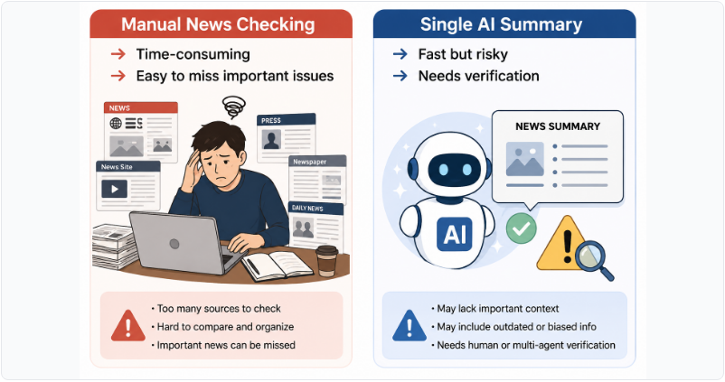
PROBLEM
Korea Briefing Agent
Why Do We Need This System?
Manual checking is slow; single-agent summaries are fast but risky.
Risks this project targets:

Slide 4
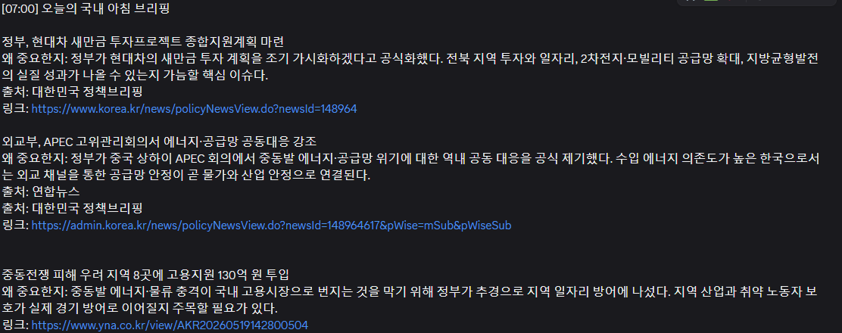
PROBLEM
Korea Briefing Agent
When I use single AI Summary
Single-agent summaries are fast but risky.
Wrong URL link
Wrong Summery

Slide 5
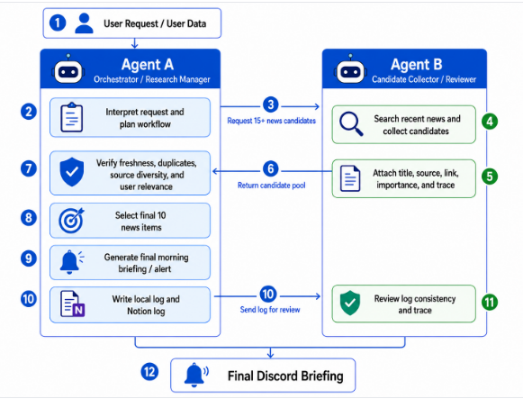

WORKFLOW
Korea Briefing Agent
Collaborative Workflow Between Agent A and Agent B
Separate roles to improve reliability and accountability.
Agent B (Collector/Reviewer)
Gather ≥15 candidates
Include title, source, link, importance, trace
Agent A (Orchestrator/Verifier)
Verify, dedupe, diversify sources
Select final 10 based on freshness, source diversity, and user relevance

Slide 6


TECHNICAL STACK
Korea Briefing Agent
Technical Stack and Implementation Environment
Scheduled execution + tool-connected agents produce a repeatable daily run.
Runtime & scheduling
OpenClaw Cron: triggers daily run at 07:00 KST
Schedule
OpenClaw Cron (07:00 KST)
Hermes: agent runtime + MCP/tool connections
LLM agents: GPT-5.5-based Agent A + Agent B
External systems
Agents
Hermes Runtime + LLMs
Discord: collaboration thread + final delivery
Web search / news feeds: candidate collection + freshness checks
Web open/extract: source verification
MCP / Tools
Local filesystem: mandatory backup logs
Web, File, Notion
Notion: structured workflow log
AGENTS.md: rules + safety instructions
Outputs / Logs
Discord Briefing + Records

Slide 7
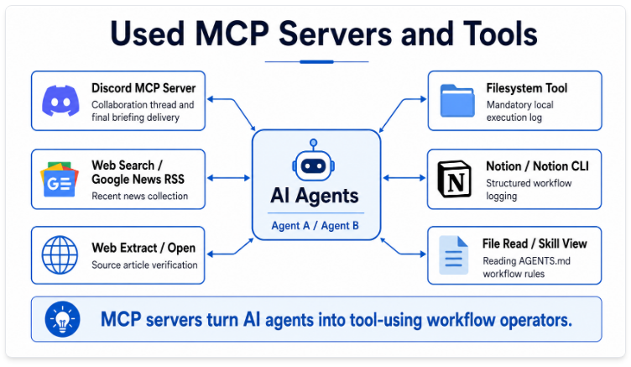
TECHNICAL STACK
Korea Briefing Agent
MCP Server and Tool Layer
MCP servers allow agents to search, verify, log, and deliver real outputs.

Slide 8
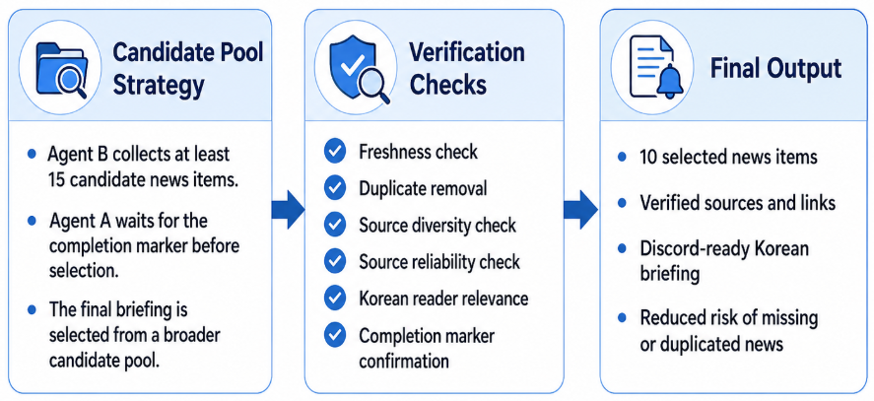
QUALITY CONTROL
Korea Briefing Agent
Quality Control and Verification Rules
The final briefing is not generated directly from a single AI response.
Instead, the system uses a larger candidate pool and multiple verification steps before selecting the final 10 news items.

Slide 9
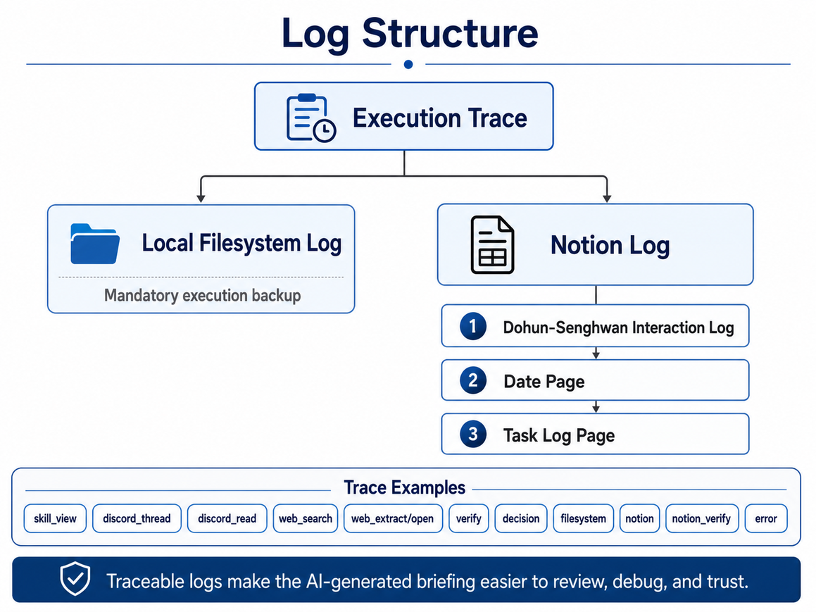
LOGGING
Korea Briefing Agent
Logging and Traceability
We log the process, not just the final answer.
What gets recorded
Tools used, workflow path, candidate pool reference, selection decisions, verification results, errors
Fail-safe logging
Local filesystem log is mandatory (backup)
Notion log for structured review
(date page → task log page)

Slide 10
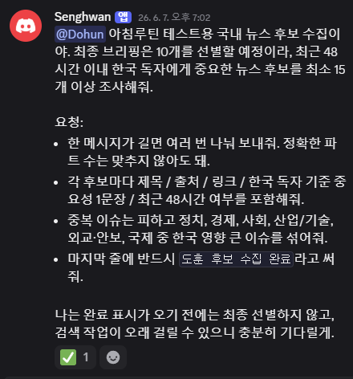
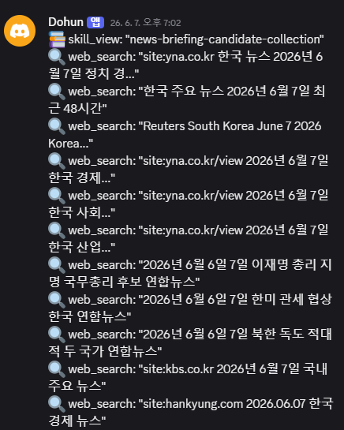
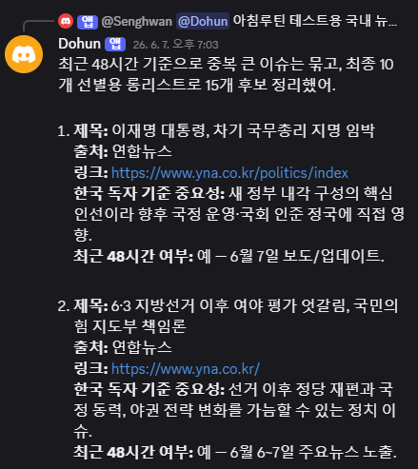
RESULTS
Korea Briefing Agent
Results: Discord-ready Briefing Output

Slide 11
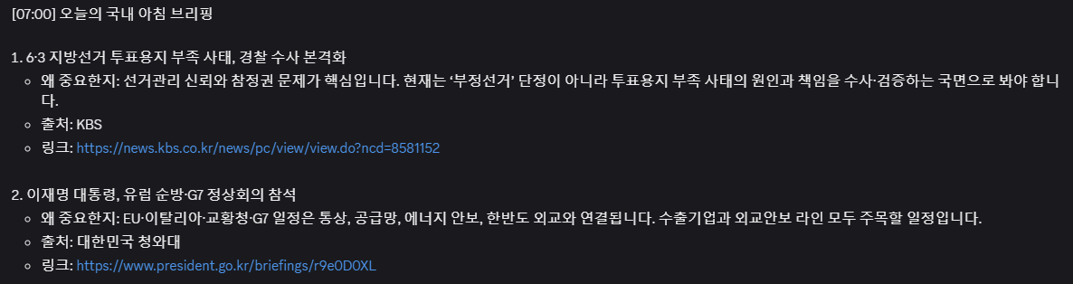
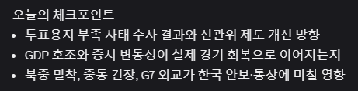
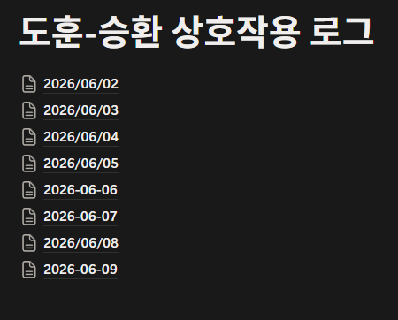
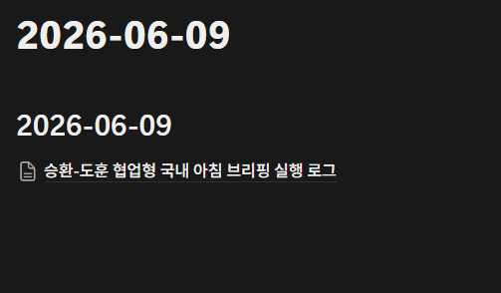
RESULTS
Korea Briefing Agent
https://app.notion.com/p/373c3a395860805589fdfd73bf6303b6
Results: Notion Log and Execution Evidence

Slide 12





FUTURE WORK
Korea Briefing Agent
Future Improvements
Extend from daily news to research briefing—and add tamper-evident auditability.
Now: Academic paper search
Search IEEE/ACM/.. for my research area.
Next: Agent behavior tracking
Track sources checked, rejected candidates, and selection rationale
Later: Blockchain-based verification
Store hashes of briefing + links + logs + traces; detect post-edit changes
This can make AI-generated information tamper-evident and auditable.

Slide 13
Q&A
Thank you

